Slide 1
Walter Shewhart & the Philosophy of Software
David Alan Grier
Center for International Science & Technology Policy
George Washington University

Slide 2
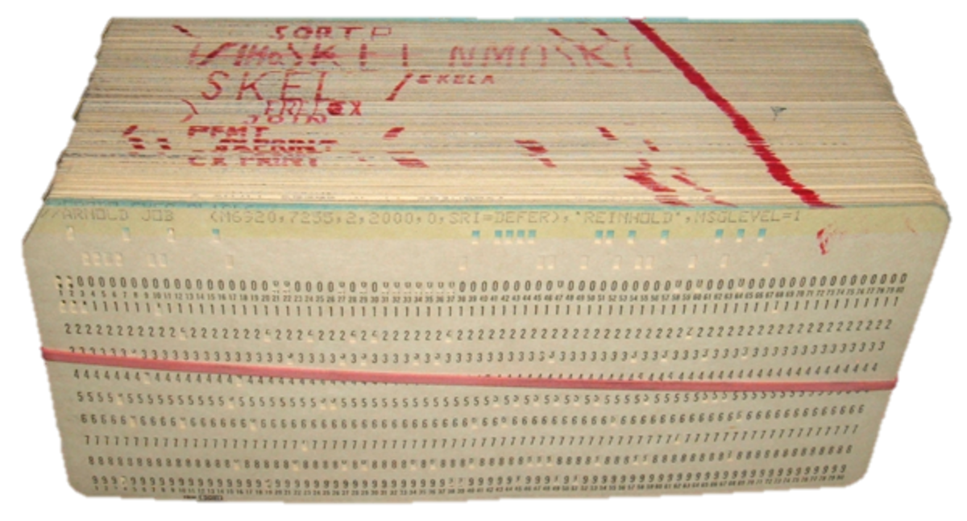
Historical Talk
Not Philosopher
Historian of Ideas
Claim to be Philosophy
Current Literature
Language & Thought
Metaphor
Materialization of Software
Engineering Perspective
Practical Problems

Slide 4
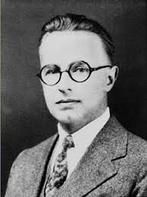
Walter Shewhart

Slide 5
Walter Shewhart
Production Engineer
Not philosopher

Slide 6
Walter Shewhart
Production Engineer
Not philosopher
Widely read in philosophy
Dewey, Bertrand Russell, C. I. Lewis

Slide 7
Walter Shewhart
Production Engineer
Not philosopher
Widely read in philosophy
Dewey, Bertrand Russell, C. I. Lewis
What is mass production?
What kind of entity is it?

Slide 8
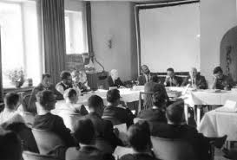
Connection to Software

Slide 9
Connection to Software
Producing Quality Software

Slide 10
Connection to Software
Producing Quality Software
Perceptions:
Error prone software
Slow delivery

Slide 11
Connection to Software
Producing Quality Software
Perceptions:
Error prone software
Slow delivery
Garmisch Conference (1968)
Nato Sponsored
Problems creating quality software

Slide 12
Connection to Software
Producing Quality Software
Perceptions:
Error prone software
Slow delivery
Garmisch Conference (1968)
Nato Sponsored
Problems creating quality software
Not amortized over different firms

Slide 13
Connection to Software
Producing Quality Software
Perceptions:
Error prone software
Slow delivery
Garmisch Conference (1968)
Nato Sponsored
Problems creating quality software
Not amortized over different firms
No software industry

Slide 14
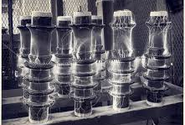
Switch Engineering Role

Slide 15
Switch Engineering Role
Electrical Engineering

Slide 16
Switch Engineering Role
Electrical Engineering
Don’t engineering electricity

Slide 17
Switch Engineering Role
Electrical Engineering
Don’t engineering electricity
Engineer machine to control electricity

Slide 18
Switch Engineering Role
Electrical Engineering
Don’t engineering electricity
Engineer machine to control electricity
Machine to control signal

Slide 19
Switch Engineering Role
Electrical Engineering
Don’t engineering electricity
Engineer machine to control electricity
Machine to control signal
Software Engineering

Slide 20
Switch Engineering Role
Electrical Engineering
Don’t engineering electricity
Engineer machine to control electricity
Machine to control signal
Software Engineering
Engineer signal to control machine

Slide 21
Switch Engineering Role
Electrical Engineering
Don’t engineering electricity
Engineer machine to control electricity
Machine to control signal
Software Engineering
Engineer signal to control machine
Continued reluctance to engineer

Slide 22
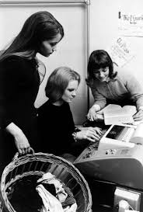
Why process started in 1968?

Slide 23
Why process started in 1968?
Software quasi-material

Slide 24
Why process started in 1968?
Software quasi-material
Punched cards / Tape

Slide 25
Why process started in 1968?
Software quasi-material
Punched cards / Tape
Not worthy of engineering

Slide 26
Why process started in 1968?
Software quasi-material
Punched cards / Tape
Not worthy of engineering
Dematerialized slowly

Slide 27
Why process started in 1968?
Software quasi-material
Punched cards / Tape
Not worthy of engineering
Dematerialized slowly
Disks

Slide 28
Why process started in 1968?
Software quasi-material
Punched cards / Tape
Not worthy of engineering
Dematerialized slowly
Disks
RAMAC (~1957)

Slide 29
Why process started in 1968?
Software quasi-material
Punched cards / Tape
Not worthy of engineering
Dematerialized slowly
Disks
RAMAC (~1957)
Time Sharing

Slide 30
Why process started in 1968?
Software quasi-material
Punched cards / Tape
Not worthy of engineering
Dematerialized slowly
Disks
RAMAC (~1957)
Time Sharing
MCP/CTSS/Multics (~1961)

Slide 31
Why process started in 1968?
Software quasi-material
Punched cards / Tape
Not worthy of engineering
Dematerialized slowly
Disks
RAMAC (~1957)
Time Sharing
MCP/CTSS/Multics (~1961)
Mini-computers (1968)

Slide 32
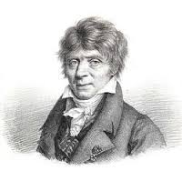
Connection between software & production

Slide 33
Connection between software & production
1793: De Prony

Slide 34
Connection between software & production
1793: De Prony
“Plan” Common term

Slide 35
Connection between software & production
1793: De Prony
“Plan” Common term
“plan general de l'execution”

Slide 36
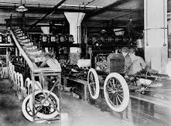
Connection between software & production
1793: De Prony
“Plan” Common term
“plan general de l'execution”
Transferred to Industrial Engineering

Slide 37
Connection between software & production
1793: De Prony
“Plan” Common term
“plan general de l'execution”
Transferred to Industrial Engineering
Division between

Slide 38
Connection between software & production
1793: De Prony
“Plan” Common term
“plan general de l'execution”
Transferred to Industrial Engineering
Division between
Mathematics

Slide 39
Connection between software & production
1793: De Prony
“Plan” Common term
“plan general de l'execution”
Transferred to Industrial Engineering
Division between
Mathematics
Coding (Mechanical Translation)

Slide 40
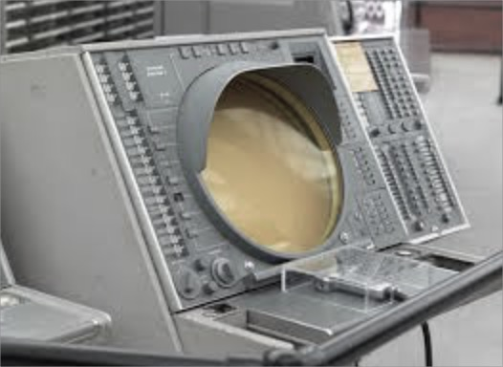
Software Breaks with Origins

Slide 41
Software Breaks with Origins
Separate Staff
SAGE (1959)

Slide 42
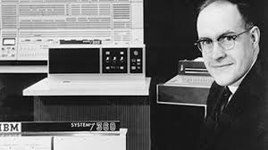
Software Breaks with Origins
Separate Staff
SAGE (1959)
Different Process
OS/360

Slide 43
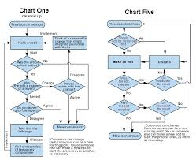
By 1968: Five Treatment Strategies

Slide 44
By 1968: Five Treatment Strategies
Mechanical Device (McIlroy)

Slide 45
By 1968: Five Treatment Strategies
Mechanical Device (McIlroy)
Axiomatic Process (Hoare)

Slide 46
By 1968: Five Treatment Strategies
Mechanical Device (McIlroy)
Axiomatic Process (Hoare)
Structured Communication (Djikstra)

Slide 47
By 1968: Five Treatment Strategies
Mechanical Device (McIlroy)
Axiomatic Process (Hoare)
Structured Communication (Djikstra)
Natural Entity (Halstead)

Slide 48
By 1968: Five Treatment Strategies
Mechanical Device (McIlroy)
Axiomatic Process (Hoare)
Structured Communication (Djikstra)
Natural Entity (Halstead)
Production Plan (Boehm)

Slide 49
All 5 remain in software todate
All 5 remain
Some more important than others
Shewharts’s apprach is core
Materialism that measuring effects

Slide 50
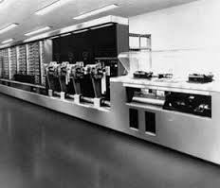
Mechanical

Slide 51
Mechanical
Dates to 1938 & Harvard Mark I

Slide 52
Mechanical
Dates to 1938 & Harvard Mark I
Parts you assemble into whole
Subroutines

Slide 53
Mechanical
Dates to 1938 & Harvard Mark I
Parts you assemble into whole
Subroutines
Surviving Elements: Libraries
Mathematical
Language
Graphic

Slide 54
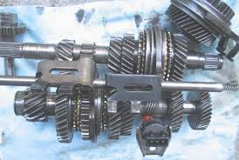
Mechanical
Shortcomings

Slide 55
Mechanical
Shortcomings
Not Sufficient

Slide 56
Mechanical
Shortcomings
Not Sufficient
Mere Analysis

Slide 57
Mechanical
Shortcomings
Not Sufficient
Mere Analysis
Mismatch material model

Slide 58
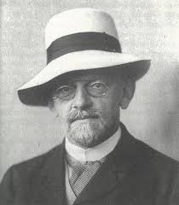
Axiomatic

Slide 59
Axiomatic
Reasoning from fixed assumptions

Slide 60
Axiomatic
Reasoning from fixed assumptions
Hilbert/Turing/Church

Slide 61
Axiomatic
Reasoning from fixed assumptions
Hilbert/Turing/Church
Algol 60
Formal Definitions

Slide 62
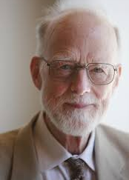
Axiomatic
Reasoning from fixed assumptions
Hilbert/Turing/Church
Algol 60
Formal Definitions
C. A. R. Hoare (1969)

Slide 63
Axiomatic
Reasoning from fixed assumptions
Hilbert/Turing/Church
Algol 60
Formal Defintions
C. A. R. Hoare (1969)

Slide 64
Axiomatic

Slide 65
Axiomatic
Surviving Elements:

Slide 66
Axiomatic
Surviving Elements:
Specification Languages

Slide 67
Axiomatic
Surviving Elements:
Specification Languages
Formal Definitions

Slide 68
Axiomatic
Surviving Elements:
Specification Languages
Formal Definitions
Academic Interest

Slide 69
Axiomatic
Surviving Elements:
Specification Languages
Formal Definitions
Academic Interest
Shortcomings

Slide 70
Axiomatic
Surviving Elements:
Specification Languages
Formal Definitions
Academic Interest
Shortcomings
Economics

Slide 71
Axiomatic
Surviving Elements:
Specification Languages
Formal Definitions
Academic Interest
Shortcomings
Economics
Mechanical Support – Stopping Problem

Slide 72
Axiomatic
Surviving Elements:
Specification Languages
Formal Definitions
Academic Interest
Shortcomings
Economics
Mechanical Support – Stopping Problem
Not Materializing at all
No artifact

Slide 73
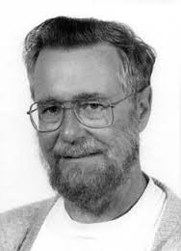
Structured Communication
Edsger Dijkstra

Slide 74
Structured Communication
Programmer – Machine
Edsger Dijkstra

Slide 75
Structured Communication
Programmer – Machine
Discipline Programmer
Edsger Dijkstra

Slide 76
Structured Communication
Programmer – Machine
Discipline Programmer
Proof Easier
Edsger Dijkstra

Slide 77
Structured Communication
Programmer – Machine
Discipline Programmer
Proof Easier
Reduce Complexity
T. H. E. Operating System
Edsger Dijkstra

Slide 78
Structured Communication
Programmer – Machine
Discipline Programmer
Proof Easier
Reduce Complexity
T. H. E. Operating System
“Goto Considered Harmful”
Edsger Dijkstra

Slide 79
Structured Communication
Letters to the Editor
Go To Statement Considered Harmful
Key Words and Phrases: go to statement, jump instruction,
branch instruction, conditional clause, alternative clause, repetitive clause, program intelligibility, program sequencing
CR Categories: 4.22, 5.23, 5.24
EDITOR :
For a number of years I have been familiar with the observation that the quality of programmers is a decreasing function of the density of go to statements in the programs they produce. More recently I discovered why the use of the go to statement has such disastrous effects, and I became convinced that the go to statement should be abolished from all "higher level" programming languages

Slide 80
Structured Communication
Letters to the Editor
Surviving Elements:
Go To Statement Considered Harmful
Key Words and Phrases: go to statement, jump instruction,
branch instruction, conditional clause, alternative clause, repetitive clause, program intelligibility, program sequencing
CR Categories: 4.22, 5.23, 5.24
EDITOR :
For a number of years I have been familiar with the observation that the quality of programmers is a decreasing function of the density of go to statements in the programs they produce. More recently I discovered why the use of the go to statement has such disastrous effects, and I became convinced that the go to statement should be abolished from all "higher level" programming languages

Slide 81
Structured Communication
Letters to the Editor
Surviving Elements:
Software Architecture
Go To Statement Considered Harmful
Key Words and Phrases: go to statement, jump instruction,
branch instruction, conditional clause, alternative clause, repetitive clause, program intelligibility, program sequencing
CR Categories: 4.22, 5.23, 5.24
EDITOR :
For a number of years I have been familiar with the observation that the quality of programmers is a decreasing function of the density of go to statements in the programs they produce. More recently I discovered why the use of the go to statement has such disastrous effects, and I became convinced that the go to statement should be abolished from all "higher level" programming languages

Slide 82
Structured Communication
Letters to the Editor
Surviving Elements:
Software Architecture
Programming Tools
Go To Statement Considered Harmful
Key Words and Phrases: go to statement, jump instruction,
branch instruction, conditional clause, alternative clause, repetitive clause, program intelligibility, program sequencing
CR Categories: 4.22, 5.23, 5.24
EDITOR :
For a number of years I have been familiar with the observation that the quality of programmers is a decreasing function of the density of go to statements in the programs they produce. More recently I discovered why the use of the go to statement has such disastrous effects, and I became convinced that the go to statement should be abolished from all "higher level" programming languages

Slide 83
Structured Communication
Letters to the Editor
Surviving Elements:
Software Architecture
Programming Tools
Shortcomings
Go To Statement Considered Harmful
Key Words and Phrases: go to statement, jump instruction,
branch instruction, conditional clause, alternative clause, repetitive clause, program intelligibility, program sequencing
CR Categories: 4.22, 5.23, 5.24
EDITOR :
For a number of years I have been familiar with the observation that the quality of programmers is a decreasing function of the density of go to statements in the programs they produce. More recently I discovered why the use of the go to statement has such disastrous effects, and I became convinced that the go to statement should be abolished from all "higher level" programming languages

Slide 84
Structured Communication
Letters to the Editor
Surviving Elements:
Software Architecture
Programming Tools
Shortcomings
Not Necessary
Go To Statement Considered Harmful
Key Words and Phrases: go to statement, jump instruction,
branch instruction, conditional clause, alternative clause, repetitive clause, program intelligibility, program sequencing
CR Categories: 4.22, 5.23, 5.24
EDITOR :
For a number of years I have been familiar with the observation that the quality of programmers is a decreasing function of the density of go to statements in the programs they produce. More recently I discovered why the use of the go to statement has such disastrous effects, and I became convinced that the go to statement should be abolished from all "higher level" programming languages

Slide 85
Structured Communication
Letters to the Editor
Surviving Elements:
Software Architecture
Programming Tools
Shortcomings
Not Necessary
Clarified Structure Not Meaning
Go To Statement Considered Harmful
Key Words and Phrases: go to statement, jump instruction,
branch instruction, conditional clause, alternative clause, repetitive clause, program intelligibility, program sequencing
CR Categories: 4.22, 5.23, 5.24
EDITOR :
For a number of years I have been familiar with the observation that the quality of programmers is a decreasing function of the density of go to statements in the programs they produce. More recently I discovered why the use of the go to statement has such disastrous effects, and I became convinced that the go to statement should be abolished from all "higher level" programming languages

Slide 86
Structured Communication
Letters to the Editor
Surviving Elements:
Software Architecture
Programming Tools
Shortcomings
Not Necessary
Clarified Structure Not Meaning
Materializing irrelevant thing
Go To Statement Considered Harmful
Key Words and Phrases: go to statement, jump instruction,
branch instruction, conditional clause, alternative clause, repetitive clause, program intelligibility, program sequencing
CR Categories: 4.22, 5.23, 5.24
EDITOR :
For a number of years I have been familiar with the observation that the quality of programmers is a decreasing function of the density of go to statements in the programs they produce. More recently I discovered why the use of the go to statement has such disastrous effects, and I became convinced that the go to statement should be abolished from all "higher level" programming languages

Slide 87
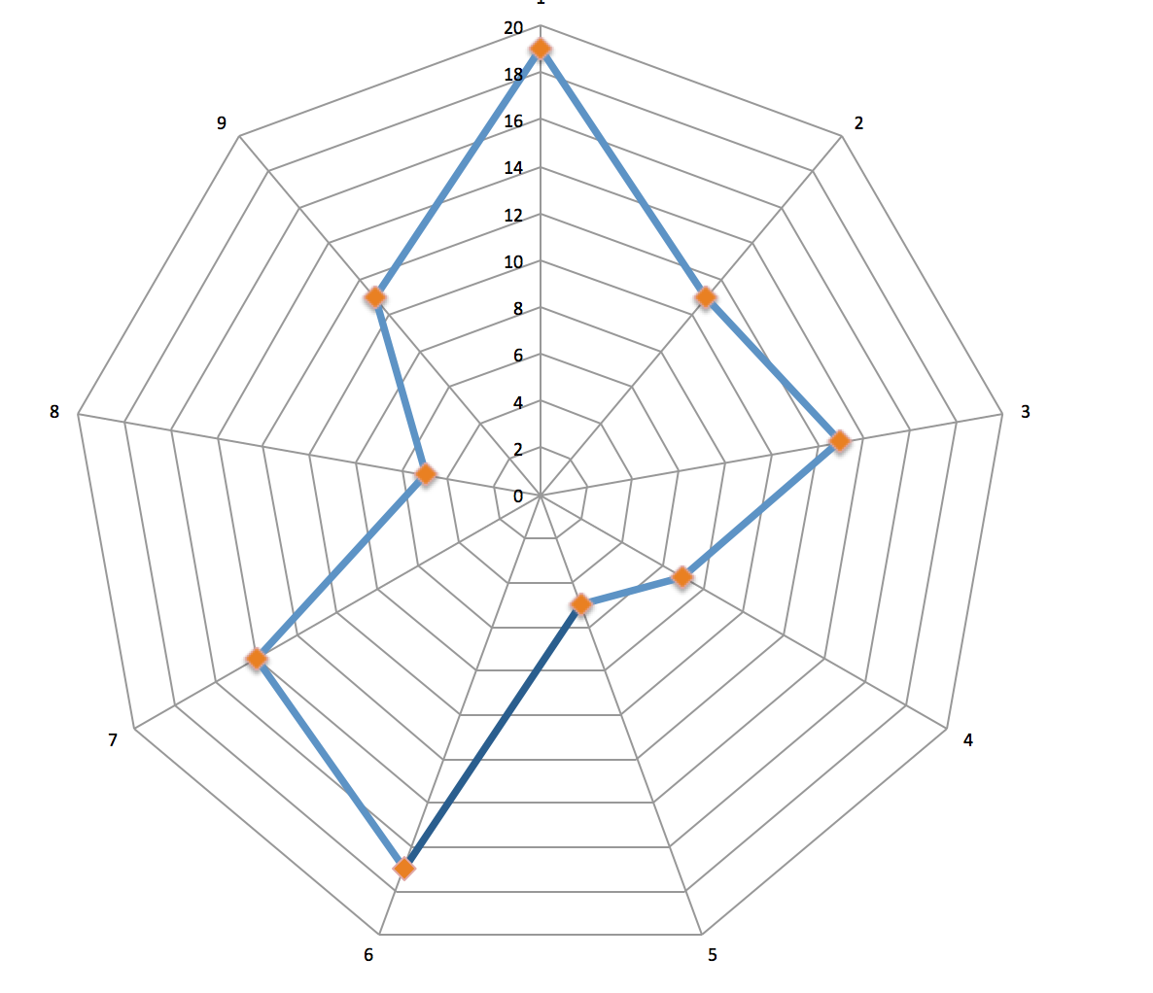
Natural Entity

Slide 88
Natural Entity
Software Science

Slide 89
Natural Entity
Software Science
Maurice Halstead

Slide 90
Natural Entity
Software Science
Maurice Halstead
Software Natural Entity

Slide 91
Natural Entity
Software Science
Maurice Halstead
Software Natural Entity
Natural Measurements

Slide 92
Natural Entity
Software Science
Maurice Halstead
Software Natural Entity
Natural Measurements
Number of Operands

Slide 93
Natural Entity
Software Science
Maurice Halstead
Software Natural Entity
Natural Measurements
Number of Operands
Program Length

Slide 94
Natural Entity
Software Science
Maurice Halstead
Software Natural Entity
Natural Measurements
Number of Operands
Program Length
Program Volume

Slide 95
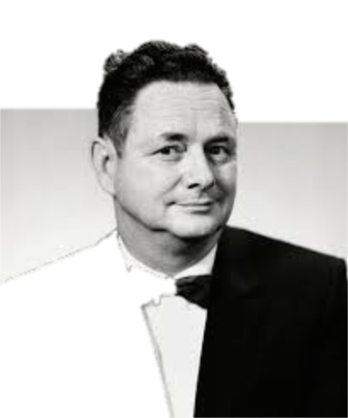
Halstead Methods

Slide 96
Halstead Methods
Surviving Elements

Slide 97
Halstead Methods
Surviving Elements
Performance Modeling

Slide 98
Halstead Methods
Surviving Elements
Performance Modeling
Shortcomings

Slide 99
Halstead Methods
Surviving Elements
Performance Modeling
Shortcomings
Not Sufficient or Necessary

Slide 100
Halstead Methods
Surviving Elements
Performance Modeling
Shortcomings
Not Sufficient or Necessary
High Variability

Slide 101
Halstead Methods
Surviving Elements
Performance Modeling
Shortcomings
Not Sufficient or Necessary
High Variability
Limited Correlation

Slide 102
Halstead Methods
Surviving Elements
Performance Modeling
Shortcomings
Not Sufficient or Necessary
High Variability
Limited Correlation
Chaotic Materiality

Slide 103
Halstead Methods
Surviving Elements
Performance Modeling
Shortcomings
Not Sufficient or Necessary
High Variability
Limited Correlation
Chaotic Materiality
Natural World

Slide 104
Production Plan

Slide 105
Production Plan
Aerospace Industry

Slide 106
Production Plan
Aerospace Industry
Barry Boehm

Slide 107
Production Plan
Aerospace Industry
Barry Boehm
Well-versed in Production

Slide 108
Production Plan
Aerospace Industry
Barry Boehm
Well-versed in Production
Complex Production

Slide 109
Production Plan
Aerospace Industry
Barry Boehm
Well-versed in Production
Complex Production
High Risk Production

Slide 110
Production Plan
Aerospace Industry
Barry Boehm
Well-versed in Production
Complex Production
High Risk Production
Software as part of plan

Slide 111
Production Plan
Aerospace Industry
Barry Boehm
Well-versed in Production
Complex Production
High Risk Production
Software as part of plan
Turned to Walter Shewhart

Slide 112
Quality Control/Assurance

Slide 113
Quality Control/Assurance
Bell Labs, 1920s

Slide 114
Quality Control/Assurance
Bell Labs, 1920s
Production Plans for Western Electric

Slide 115
Quality Control/Assurance
Bell Labs, 1920s
Production Plans for Western Electric
What is Quality?

Slide 116
Quality Control/Assurance
Bell Labs, 1920s
Production Plans for Western Electric
What is Quality?
Basis for Work

Slide 117
Quality Control/Assurance
Bell Labs, 1920s
Production Plans for Western Electric
What is Quality?
Basis for Work
Materialization of Modern Physics

Slide 118
Quality Control/Assurance
Bell Labs, 1920s
Production Plans for Western Electric
What is Quality?
Basis for Work
Materialization of Modern Physics
Materializing Quality of System

Slide 119
Clarence I. Lewis
C. I. Lewis (1983-1964)

Slide 120
Clarence I. Lewis
Student of Royce
C. I. Lewis (1983-1964)

Slide 121
Clarence I. Lewis
Student of Royce
Mathematical Logic
C. I. Lewis (1983-1964)

Slide 122
Clarence I. Lewis
Student of Royce
Mathematical Logic
A ➔B ≠ (Not A)∨B
C. I. Lewis (1983-1964)

Slide 123
Clarence I. Lewis
Student of Royce
Mathematical Logic
A ➔B ≠ (Not A)∨B
Follower of Dewey
C. I. Lewis (1983-1964)

Slide 124
Clarence I. Lewis
Student of Royce
Mathematical Logic
A ➔B ≠ (Not A)∨B
Follower of Dewey
Pragmatist
C. I. Lewis (1983-1964)

Slide 125
Clarence I. Lewis
Student of Royce
Mathematical Logic
A ➔B ≠ (Not A)∨B
Follower of Dewey
Pragmatist
“Pragmatism is a Process”
C. I. Lewis (1983-1964)

Slide 126
Clarence I. Lewis
Student of Royce
Mathematical Logic
A ➔B ≠ (Not A)∨B
Follower of Dewey
Pragmatist
“Pragmatism is a Process”
Effects of Process not system
C. I. Lewis (1983-1964)

Slide 127
Materializing Quality
Statistical Quality Control (1939)

Slide 128
Materializing Quality
Object
Statistical Quality Control (1939)

Slide 129
Materializing Quality
Object
Go/No Go Gauges
Statistical Quality Control (1939)

Slide 130
Materializing Quality
Object
Go/No Go Gauges
Quality is Nd parallelepiped
Statistical Quality Control (1939)

Slide 131
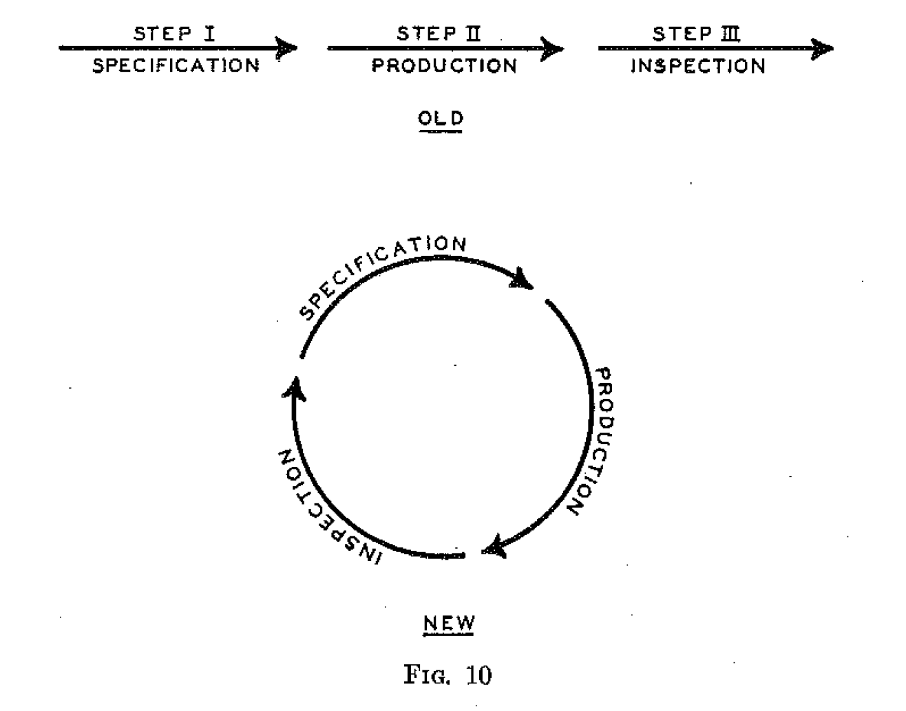
Materializing Quality
Object
Go/No Go Gauges
Quality is Nd parallelepiped
Moved from Object to Process
Statistical Quality Control (1939)

Slide 132
Materializing Quality
Object
Go/No Go Gauges
Quality is Nd parallelepiped
Moved from Object to Process
Process as means for controlling
system
Statistical Quality Control (1939)

Slide 133
Materializing Quality
Object
Go/No Go Gauges
Quality is Nd parallelepiped
Moved from Object to Process
Process as means for controlling
system
Controllable Causes
Statistical Quality Control (1939)

Slide 134
Materializing Quality
Object
Go/No Go Gauges
Quality is Nd parallelepiped
Moved from Object to Process
Process as means for controlling
system
Controllable Causes
Uncontrollable Causes
Statistical Quality Control (1939)

Slide 135
Materializing Quality
Object
Go/No Go Gauges
Quality is Nd parallelepiped
Moved from Object to Process
Process as means for controlling
system
Controllable Causes
Uncontrollable Causes
Materialism of System implies materialism of software
Statistical Quality Control (1939)

Slide 136
Shewhart’s Philosophical Problem

Slide 137
Shewhart’s Philosophical Problem
Causality Problem

Slide 138
Shewhart’s Philosophical Problem
Causality Problem
Specify
Want for operation

Slide 139
Shewhart’s Philosophical Problem
Causality Problem
Specify
Want for operation
Production
Adjust manufacture

Slide 140
Shewhart’s Philosophical Problem
Causality Problem
Specify
Want for operation
Production
Adjust manufacture
Inspect
What you can see
(nondestructive)
(sample destructive)

Slide 141
Pragmatic Solution

Slide 142
Pragmatic Solution
Align Controllable Influences

Slide 143
Pragmatic Solution
Align Controllable Influences
Equalize Variation of Uncontrollable

Slide 144
Pragmatic Solution
Align Controllable Influences
Equalize Variation of Uncontrollable
Largely overlooked in modern applications

Slide 145
Pragmatic Solution
Align Controllable Influences
Equalize Variation of Uncontrollable
Largely overlooked in modern applications
Assume fundamental materialism

Slide 146
Pragmatic Solution
Align Controllable Influences
Equalize Variation of Uncontrollable
Largely overlooked in modern applications
Assume fundamental materialism
Underlying thing

Slide 147
Pragmatic Solution
Align Controllable Influences
Equalize Variation of Uncontrollable
Largely overlooked in modern applications
Assume fundamental materialism
Underlying thing
Materialized process

Slide 148
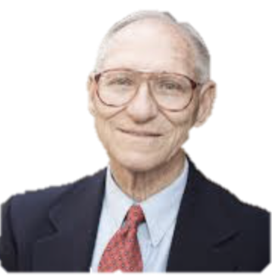
Transfer to Software
Barry Boehm)

Slide 149
Transfer to Software
Materializing Action of System
Barry Boehm)

Slide 150
Transfer to Software
Materializing Action of System
Quality is Uniform Action
Barry Boehm)

Slide 151
Transfer to Software
Materializing Action of System
Quality is Uniform Action
Controllable forces more general
Barry Boehm)

Slide 152
Transfer to Software
Materializing Action of System
Quality is Uniform Action
Controllable forces more general
Uncontrollable forces more prevalent
Barry Boehm)

Slide 153
Transfer to Software
Materializing Action of System
Quality is Uniform Action
Controllable forces more general
Uncontrollable forces more prevalent
Implemented in Standards
Barry Boehm)

Slide 154
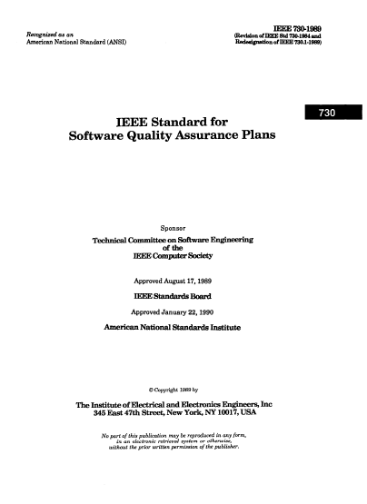
IEEE Standardization

Slide 155
IEEE Standardization
Begins in 1978

Slide 156
IEEE Standardization
Begins in 1978
IEEE 730: Quality Assurance Plans

Slide 157
IEEE Standardization
Begins in 1978
IEEE 730: Quality Assurance Plans
Defining material (measurable) nature of software

Slide 158
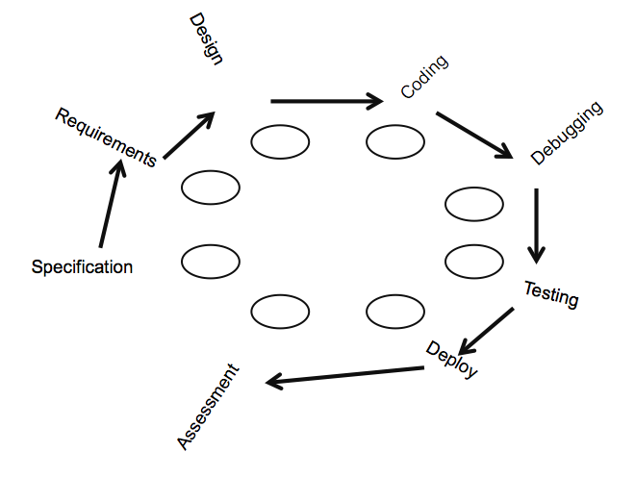
IEEE Computer Society Progress

Slide 159
IEEE Computer Society Progress
829 Software Test Documentation (1983)

Slide 160
IEEE Computer Society Progress
829 Software Test Documentation (1983)
830 Requirements Specification (1984)

Slide 161
IEEE Computer Society Progress
829 Software Test Documentation (1983)
830 Requirements Specification (1984)
1002 Taxonomy for Software Standards (1987)

Slide 162
IEEE Computer Society Progress
829 Software Test Documentation (1983)
830 Requirements Specification (1984)
1002 Taxonomy for Software Standards (1987)
730 Quality Assurance Plans (1988)

Slide 163
IEEE Computer Society Progress
829 Software Test Documentation (1983)
830 Requirements Specification (1984)
1002 Taxonomy for Software Standards (1987)
730 Quality Assurance Plans (1988)
982 Measures of Dependability (1988)

Slide 164
IEEE Computer Society Progress
829 Software Test Documentation (1983)
830 Requirements Specification (1984)
1002 Taxonomy for Software Standards (1987)
730 Quality Assurance Plans (1988)
982 Measures of Dependability (1988)
828 Configuration Management (1990)

Slide 165
IEEE Computer Society Progress
829 Software Test Documentation (1983)
830 Requirements Specification (1984)
1002 Taxonomy for Software Standards (1987)
730 Quality Assurance Plans (1988)
982 Measures of Dependability (1988)
828 Configuration Management (1990)
1074 Software Lifecycle (1991)

Slide 166
What do we learn about Philosophy?
Engineers more Pragmatists than we thought
Less Rational Positivists
Clearly Mathematical Logic still important
Materialize Problem
Identify aspects that can be put in box
Solve those aspects
Limit Influence of all else

Slide 167
Walter Shewhart & the Philosophy of software
David Alan Grier

